Slide 1
Articulation…More than Just Tonguing
University of North Texas Clarinet Faculty
Daryl Coad
Deborah Fabian
Kimberly Cole Luevano
John Scott
Notes:
----- Meeting Notes (2/12/16 12:31) -----

Slide 3
“In the beginning was the Slur….”
Does your clarinet section sound better when they slur or when they tongue?
Nothing works without air
Efficiency, balance and relaxation
Breathing: tummy, down/out/away
Shoulders: circles not up/down
More on this from Daryl Coad momentarily….

Slide 4
Once the tone and blowing have been established, add the tongue.
“Tip to tip” is the most common technique.
Actually: “Top of the tip of the tongue to the bottom of the tip of the reed.”
hah-tah or hah-dah
perhaps hAH-tAH or hAH-dAH
hah-dah-dah-dah
or hAH-dAH-dAH-dAH
It’s all about frogs catching flies!

Slide 5
The tongue either releases (the first notes) or interrupts the sound
NB: These are very different techniques!
Three parts to a sound:
Beginning Start Attack*
Middle Tone Duration
End Stop Release*
*Why do we use these words when we really release to attack and attack to release?

Slide 6
*Why do we use these words when we really release to attack and attack to release?
Tonguing is not a military battle:
forward/ATTACK, back/RETREAT (RELEASE)
Tonguing is about the backstroke (the release of air): The tongue is not a rivet gun.

Slide 7
Air Strategies
Everything originates with the wind.
Good sound is first and foremost a function of a strong wind column.
Of course voicing, tongue position and embouchure structure matter, but without the wind, NONE of it matters. Without the wind, the kite will not fly.
Good articulation is 95% Wind/Voicing/Embouchure Structure + 5% tongue….
……Not vice-versa.

Slide 8
Air resources
Helpful tools your students already have:
Barrel/Bell
Swab
BAT-BERP Website
Breathing Awareness Tool (BAT) for $29.95, distributed by BERP Company (Buzz Extension and Resistance Piece).
http://www.berp.com/product/bat/
Windsong Press Website:
This site contains all of the devices Arnold Jacobs used to train wind players to use their full capacity.
http://www.windsongpress.com/breathing%20devices/breathing%20devices.htm

Slide 9
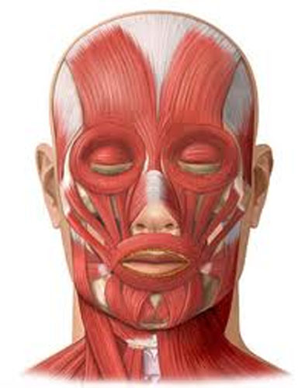
Embouchure Structure
Developed embouchure structure is critical to articulation success.

Slide 10
Embouchure essentials:
Pressure around mouthpiece remains constant all the time.
Mouthpiece is “snug” against top teeth; facial muscles hold and form a firm-yet peaceful-seal around the mouthpiece.
Embouchure should be set before blowing. (bottom lip is often too loose or unengaged.)
Recommend setting embouchure first before inserting mouthpiece.
Can students form embouchure without clarinet?

Slide 11
Embouchure essentials, continued:
Jaws and lips do not move with tongue. Use of a mirror is the best way to detect unnecessary movement.
Facial appearance should be the same in all registers and articulations.
“Chewing” or visible movement is undesirable.
Movement in jaws or lips is indicative of a more serious issue requiring attention.
Throat stays open and relaxed as tongue moves.
Use soda straw to help students develop awareness.
Ideally no throat movement. Can indicate tongue is moving too much or may not be in ideal shape for optimal sound.

Slide 12
Common embouchure problems:
“Biting”: excessive jaw pressure, not enough lip pressure/structure
Solutions?
Double lip: use to develop uniform and balanced muscular structure
Embouchure “Sprints” with pencil to help develop/ understand the desirable amount of space between back molars.
Mouthpiece angle: should be about 45 degrees.
(though depends on facial structure)
Not enough mp in mouth
How to find appropriate placement?

Slide 13
Once embouchure is well established:
Tip to tip
Actually: “Top of the tip of the tongue to the bottom of the tip of the reed.”
How to find tip of tongue?
scratch with fingernail
magic marker
coffee cup lip

Slide 14
Common articulation problems?
BEWARE these typical student survival techniques:
“Coughing”
Roof of the mouth…..
Tonguing the bottom lip?
Too much tongue surface

Slide 15
VOICING
THE ‘OFTEN NEGLECTED’ IMPORTANCE OF THE TONGUE IN SHAPING THE CLARINET TONE AND PITCH
The tongue plays an extremely important role in tonal production and tuning by controlling the air flow, speed, and direction of the breath to create a colorful, warm, resonant sound.
Successful tonal and pitch production comes with understanding proper tongue position as well as a supported air stream and a correctly formed embouchure that has NOT been trained to bite.

Slide 16
We have numerous choices using both embouchure and tongue position in both tonal and pitch production.

Slide 17
Techniques to help identify correct position of the tongue in the mouth when voicing:
Developing a good tonal concept
Using language to understand the choices we have in voicing
Using the voice to demonstrate the many choices we have for tongue placement
Italian style articulation
You can demonstrate even more with the mouthpiece and barrel!

Slide 18
WHY DO STUDENTS OFTEN GET A BETTER SOUND SLURRING RATHER THAN TONGUING?
TONGUE PLACEMENT ON THE REED
Tongue and slur with the same tongue position/voicing.
It is most important that the desired position of the tongue while voicing remain the same while articulating.

Slide 19
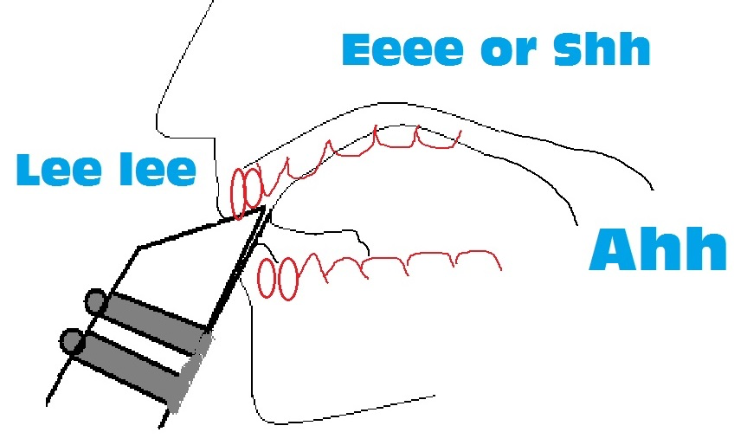

Slide 20
In conclusion:
Points to remember to help your students:
Have appropriate equipment especially mouthpiece/reed combination
2. Develop a good concept of clarinet tone
3. Well supported airstream
4. Correctly formed embouchure
5. Correct position of the tongue for voicing
6. Keep the same desired voicing position of the tongue while articulating

Slide 21
Questions?
What questions do you have for us?
What are your experiences with your own students?

Slide 22
How can we help?
Please feel free to contact us if we can be of assistance:
Daryl.Coad@unt.edu
Deborah.Fabian@unt.edu
Kimberly.Cole@unt.edu
John.Scott@unt.edu
clarinet.music.unt.edu

Slide 23
UNT ClarEssentials Summer Workshops for High School and Middle School Students:
High school:
June 22-25, 2016 (UNT Campus)
Middle School:
June 6-8, 2016 (Denton)
June 13-15, 2016 (Frisco)
clarinet.music.unt.edu/claressentials

